Slide 1

William M. Finch
Elementary School
GO TEAM MEETING
Jan. 26th, 2023
Notes:
Good Morning/Afternoon! Today we begin the process of planning our school’s budget for FY23. I know we are all here for the same reason and that is ensuring success for all (enter school name) students. This meeting is to provide an overview of the draft budget and for you to give feedback on the draft budget.

Slide 2

GO TEAM MEMBERS 2022-2023
NAME | ROLE
Dr. Tara Spencer | Principal
Ms. Ieshia Freeman | Parent
Ms. Melinda Malone | Parent
Ms. Terrion Moody | Parent
Ms. Nartasha Smith-Willis | Staff
Ms. Seggee Davis | Staff
Ms. Erin Gore | Staff
Ms. Terra Washington | Community Member
Mr. Terry Lee | Community Member
Ms. Wanda Washington | Swing Seat
Roll Call

Slide 3

Action Items
.
Approval of Agenda
Approval of Previous Minutes
Fill Officer Seat of Cluster Representative (TBD)
Review and Approval of Strategic Plan
Action Items

Slide 4

Public Comment
Opportunities for public comment are available for Finch Elementary School GO TEAM to hear from members of the community.
If the meeting is held virtually, stakeholders wishing to provide comments during GO TEAM meetings should join the link at least 10 minutes before the meeting begins and sign in.
If the meeting is held face to face, stakeholders wishing to provide comments during GO TEAM meetings should arrive at the Finch Elementary Media Center at least ten (10) minutes before the meeting begins and sign in. Stakeholders’ comments will be heard in the order in which individuals signed in.
Twenty (20) minutes of time during the GO TEAM meeting will be offered to the public to make comments. Everyone is asked to please plan to speak no more than two (2) minutes.
GO TEAM members will not provide a response or engage in direct conversation during meetings.

Slide 5
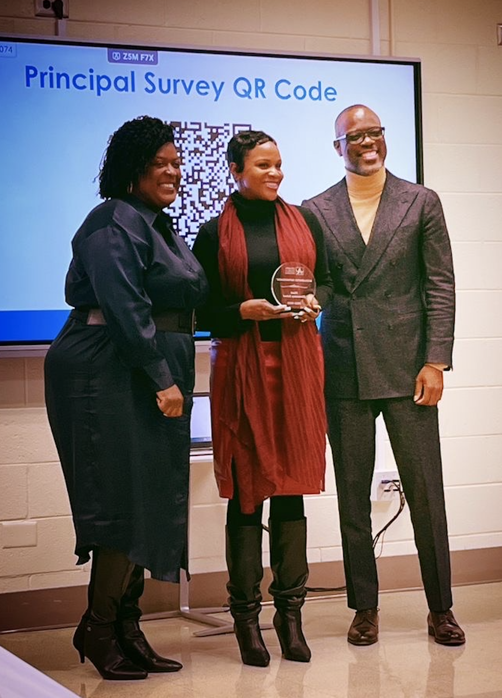
ACES Review

Slide 6

GO Team Budget Development Process
YOUR SCHOOL STRATEGIC PLAN…
is your roadmap and your role.
It is your direction, your priorities, your vision, your present, your future.
Step 1: Data Review
Step 2: Strategic Plan Review
Step 3: Budget Parameters
(Strategic Priorities)
Step 4: Budget Choices
Notes:
Today I will provide an overview of the budget allocations for FY23. We will begin the work of funding the strategic priorities we agreed upon during our strategic review meeting. (IF YOU HAVE NOT DECIDED ON YOUR PRIORITIES, YOU WILL SAY – WE WILL DECIDE ON OUR PRIORITIES AND THEN DISCUSS ALLOCATING FUNDS TO ADDRESS THOSE PRIORITIES).

Slide 7
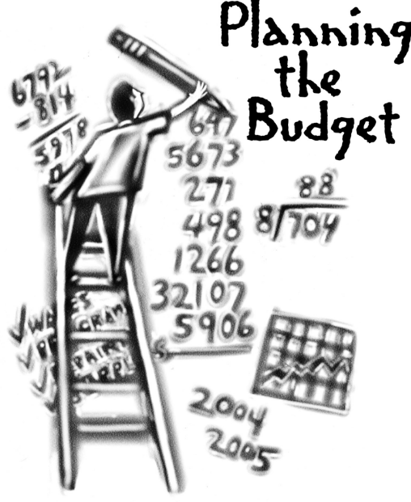
Overview of FY ‘24 GO Team Budget Process
Step 1 Review and Update Strategic Plan and Rank Strategic Priorities
By end of Fall Semester
Step 6 Principals: HR Staffing Conferences Begin
Late February – Early March
Step 3 GO Team Initial Budget Session: Allocation
January 24 – early February
Step 7 GO Team Final Budget Approval Meeting
Budgets Approved by March 17
Step 5
GO Team Feedback Session: Draft Budget Presented & Discussed February – multiple meetings, if necessary
Step 4 Principals: Associate Supt. Discussions and Review
February (supports needed, specific challenges, coaching)
Step 2 Principals: Workshop FY 24 Budget
January 24
GO Teams are encouraged to have ongoing conversations

Slide 8
Budget Allocation Meeting
What
The first GO Team meeting is when the principal will provide an overview of the budget allocation for GO Team members and the general public.
Why
This meeting provides an opportunity for the principal and GO Team to ensure alignment on the school’s key strategic priorities, gain a deeper understanding of the budget allocation, and provide input to drive the direction of the draft budget.
When
End of January- Early February

Slide 9
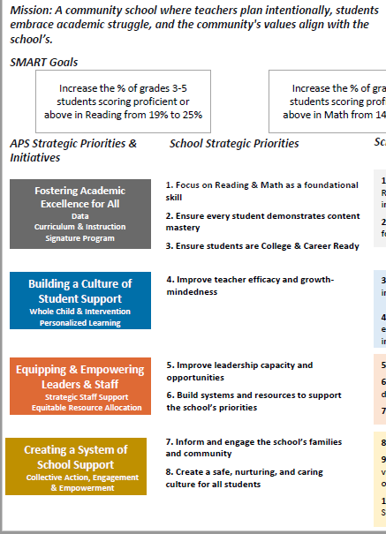
FY24 Budget Development Process
Principal’s Role
Design the budget and propose operational changes that can raise student achievement
Flesh out strategies, implement and manage them at the school level
Focus on the day-to-day operations
Serve as the expert on the school
Hire quality instructional and support personnel
The GO Team’s Role
Focus on the big picture (positions and resources, not people)
Ensure that the budget is aligned to the school’s mission and vision and that resources are allocated to support key strategic priorities

Slide 10
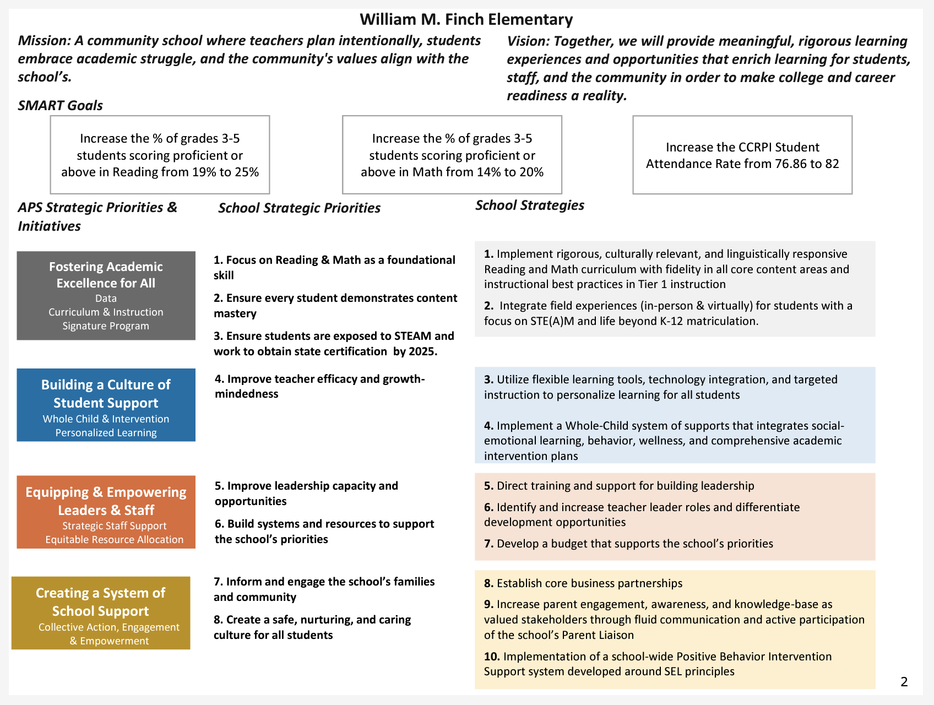

(School Name) Strategic Plan
(Insert Copy of Approved Strategic Plan Here)
Notes:
You should have a copy of our updated strategic plan (please make copies to be distributed to team).

Slide 11
Strategic Plan Priority Ranking
Higher
Lower

Slide 12
FY24 Budget Parameters
FY24 School Priorities | Rationale
Focus on Reading and Math as a foundational skill; Ensure students reach content mastery. | Secure foundational skills in literacy and math are crucial for students' success in college, career, and life and are considered key enablers of equity.
Ensure students are exposed to STE(A)M and work to obtain state certification by 2025. | STEAM inspires inquiry and curiosity; it empowers students to ask thought-provoking questions that promote creativity and exploration. Students are able to connect their problem-solving to real-world solutions.
Improve teacher efficacy and growth mindedness. | Teachers' self-efficacy, namely teachers' beliefs in their ability to effectively handle the tasks, obligations, and challenges related to their professional activity, plays a key role in influencing important academic outcomes
Notes:
Review the priorities that the GO Team has developed and the rationale for these priorities. Feel free to copy this slide if you have more than 3 priorities to account for.

Slide 13
FY24 Budget Parameters
FY24 School Priorities | Rationale
Improve leadership capacity and build opportunities. | Leadership capacity is the ability to reflect on the way in which you lead to develop more effective ways to get results.
Build systems and resources to support the school’s priorities. | Ensure that students are receiving maximized opportunities for achievement and remediation daily
Inform and engage the school’s families and communities. | Research shows that parent engagement in schools is closely linked to better student behavior, higher academic achievement, and enhanced social skills.
Create a safe, nurturing and caring culture for all students. | Safe and nurturing environments help to improve scholars' academic performance, curtail bullying, reduce dropout rates, and build character.
Notes:
Review the priorities that the GO Team has developed and the rationale for these priorities.

Slide 14
Discussion of Budget Summary
(Step 4: Budget Choices)

Slide 15
Executive Summary
This budget represents an investment plan for our school’s students, employees and the community as a whole.
The budget recommendations are tied directly to the school’s strategic vision and direction.
The proposed budget for the general operations of the school are reflected at $6,088,731.
This investment plan for FY24 accommodates a student population that is projected to be 335 students, which is an increase of 56 students from FY23.
Notes:
Here’s a few highlights for our budget this year – read executive summary

Slide 16
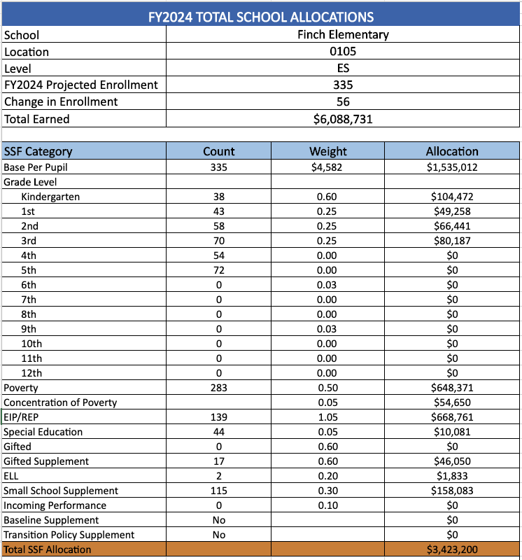
School Allocation
Notes:
For FY23, APS is continuing to increase equity within the District and the flexibility principals have in regards to our schools budgeted funds. The new Student Success Funding Model (SSF) allocates dollars to schools based on the number of enrolled students and receives a funding "weight" based on need. This year, student characteristics were weighted based on:
Grade Level –
K-12
Poverty – Weighted for all Direct Certification enrolled students.
Beginning Performance – Weighted Middle School and High School students entering with beginner’s performance on milestones.
ESOL – Weighted for all ESOL designated students in order to supplement due to ESOL staff being locked.
Special Education - Weighted for all Special Education students.
Gifted – Weighted and measured by number of students in the Gifted Program
Small School Supplement – Weighted for low enrollment schools
ES – 500
MS – 600
HS – 700
As you can see, our projected enrollment for FY23 is _______, we increased/decreased by __________ from last year.
We received the following weights for our student characteristics: (Below is just for the script, principals need to insert their school’s characteristics)
Grade Level
Poverty
Special Education
Gifted
Gifted Supplement
ELL
Small School Supplement

Slide 17
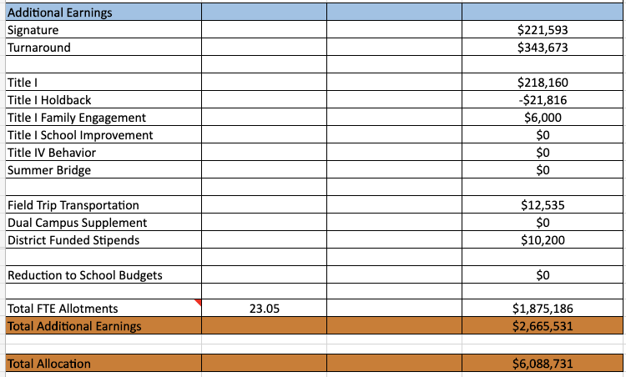
School Allocation
Notes:
Additionally, we received money for signature programming, turnaround, Title I and FTE Allotments.

Slide 18
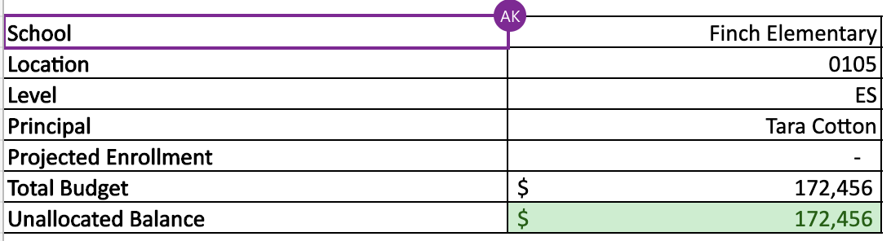
School FY24 CARES Allocation
In addition to a General Fund allocation, our school has been allocated CARES funding that must be used to support implementation of the school-based intervention block and other school-based needs as a result of the COVID-19 Pandemic.
Once the support needed to implement our school-based intervention block/course has been fulfilled, we can use the remaining CARES funds to address other school-based needs that are a result of the COVID-19 Pandemic.
Notes:
Please add your school’s CARES Allocation to this slide.

Slide 19
CARES Allocations
Other allowable CARES expenditures include:
Technology Support: Software, assistive technology, online learning platforms, subscriptions.
Mental and Physical Health: Cover the costs of additional counseling, telehealth, therapeutic services, and wraparound services and supports (contracted hours, professional learning, programs)
Supplemental Learning: Cover costs of remediation, and/or enrichment opportunities during the school year for students (afterschool programs, additional pay for teachers and staff, transportation).
Professional Development: Cover costs of additional professional development for school leaders, teachers, and staff (trainings, extended professional development days, consultants, programs).
At-risk Student Populations: Cover costs of school specific activities, services, supports, programs, and/or targeted interventions directly addressing the needs of low-income students, SWD, racial & ethnic minorities, ELL, migrant & homeless students, and students in foster care.
Continuity of Core Staff and Services. Restore any potential LEA FY22 budget reductions due to decreased state and/or local revenue.

Slide 20
What’s Next?
January
  GO Team Budget Allocation Meeting (Jan. 24th-early February)
February
  One-on-one Associate Superintendent discussions
  Cluster Planning Session (positions sharing, cluster alignment, etc.)
  Program Manager discussions and approvals
  GO Team Feedback Meeting(s) before principal’s staffing conference
  HR Staffing Conferences (Late February)
March
  Final GO Team Approval Meeting (AFTER your school’s Staffing Conference and BEFORE Friday, March 17th)
Notes:
In February, we will meet again to discuss how the school’s budget has been allocated to support the programmatic needs and FY23 key strategic priorities.
If think we need to continue our budget conversations, we will schedule additional meetings. My goal is to make sure your voices are reflected in our school’s budget.
I will also be meeting with my Associate Superintendent, program managers and other key leaders to go over our budget and to make sure the school is meeting the standards of service and appropriately staffing.
During the week of Feb. 24th -March 2nd , HR Staffing Conferences will be held. At this meeting, I will present my plan for staff utilization, resource distribution and plan for staffing implications.
We will need to approve the budget at the ________ meeting.

Slide 21

Questions?
Thank you for your time and attention.
Notes:
IF YOU FEEL YOUR TEAM IS READY TO APPROVE THE DRAFT BUDGET, PLEASE DO SO. PLEASE REMIND THEM THAT YOU MAY NEED TO MEET WITH THEM AGAIN, IF THERE ARE CHANGES FROM YOUR MEETINGS WITH DISTRICT LEADERSHIP. LET THEM KNOW YOU WILL KEEP THEM INFORMED!!

Slide 22
Announcements and Upcoming Events
  a. Next Meeting: February 9th, 2023 @ 3:30PM
  b. Winter Break Recess- February 20th – 24th

Slide 23

Meeting Adjournment

